Slide 1
Digital Design &
Computer Architecture
Sarah Harris & David Harris
Chapter 2:
Combinational Logic Design

Slide 2
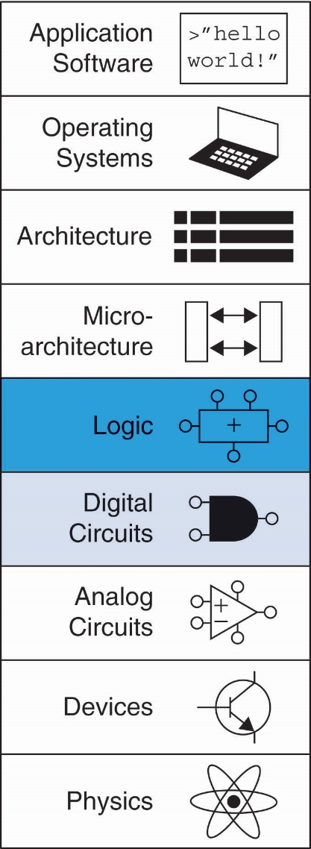
Chapter 2 :: Topics
Combinational Circuits
Boolean Equations
Boolean Algebra
From Logic to Gates
X’s and Z’s, Oh My
Karnaugh Maps
Combinational Building Blocks
Timing

Slide 3
Chapter 2: Combinational Logic
Combinational Circuits

Slide 4
Introduction
A logic circuit is composed of:
Inputs
Outputs
Functional specification
Timing specification

Slide 5
Circuits
Nodes
Inputs: A, B, C
Outputs: Y, Z
Internal: n1
Circuit elements
E1, E2, E3
Each a circuit

Slide 6
Types of Logic Circuits
Combinational Logic
Memoryless
Outputs determined by current values of inputs
Sequential Logic
Has memory
Outputs determined by previous and current values of inputs

Slide 7
Rules of Combinational Composition
Every element is combinational
Every node is either an input or connects to exactly one output
The circuit contains no cyclic paths
Example:

Slide 8
Chapter 2: Combinational Logic
Boolean Equations

Slide 9
Boolean Equations
Functional specification of outputs in terms of inputs
Example: S = F(A, B, C_{in})
C_{out} = F(A, B, C_{in})

Slide 10
Some Definitions
Complement: variable with a bar over it
A, B, C
Literal: variable or its complement
A, A, B, B, C, C
Implicant: product of literals
ABC, AC, BC
Minterm: product that includes all input variables
ABC, ABC, ABC
Maxterm: sum that includes all input variables
(A+B+C), (A+B+C), (A+B+C)

Slide 11
Sum-of-Products Form
Sum-of-Products (SOP) Form
All Boolean equations can be written in SOP form
Each row has a minterm
A minterm is a product (AND) of literals
Each minterm is TRUE for that row (and only that row)
Form function by ORing minterms where output is 1
Thus, a sum (OR) of products (AND terms)
0
1
0
1
Y = F(A, B) =

Slide 12
Sum-of-Products Form
Sum-of-Products (SOP) Form
All Boolean equations can be written in SOP form
Each row has a minterm
A minterm is a product (AND) of literals
Each minterm is TRUE for that row (and only that row)
Form function by ORing minterms where output is 1
Thus, a sum (OR) of products (AND terms)
Y = F(A, B) = AB + AB = Σ(1, 3)
Long-hand
Short-hand

Slide 13
Product-of-Sums (POS) Form
All Boolean equations can be written in POS form
Each row has a maxterm
A maxterm is a sum (OR) of literals
Each maxterm is FALSE for that row (and only that row)
Form function by ANDing maxterms where output is 0
Thus, a product (AND) of sums (OR terms)
Y = F(A, B) = (A + B)●(A + B) = Π(0, 2)
Long-hand
Short-hand

Slide 14
Boolean Equations Example
You are going to the cafeteria for lunch
You won’t eat lunch (E = 0)
If it’s not clean (C = 0) or
If they only serve meatloaf (M = 1)
Write a truth table for determining if you will eat lunch (E).

Slide 15
SOP & POS Form
SOP – sum-of-products
POS – product-of-sums

Slide 16
SOP & POS Form
SOP – sum-of-products
POS – product-of-sums
E = CM
= Σ(2)
E = (C + M)(C + M)(C + M)
= Π(0, 1, 3)

Slide 17
Forming Boolean Expressions
Example 1:
We will go to the Park (P is the output) if it’s not Raining (R) and we have Sandwiches (S).
Boolean Equation:
P = RS

Slide 18
Forming Boolean Expressions
Example 2:
You will be considered a Winner (W is the output) if we send you a Million dollars (M) or a small Notepad (N).
Boolean Equation:
W = M + N

Slide 19
Forming Boolean Expressions
Example 3:
You can Eat delicious food (E is the output) if you Make it yourself (M) or you have a personal Chef (C) and she/he is talented (T) but not eXpensive (X).
Boolean Equation:
E = M + CTX

Slide 20
Forming Boolean Expressions
Example 4:
You can Enter the building if you have a Hat and Shoes on or if you have a Hat on.
Boolean Equation:
E = HS + H

Slide 21
Forming Boolean Expressions
Example 5:
You can Enter the building if you have a Hat and Shoes on or if you have a Hat and no Shoes on.
Boolean Equation:
E = HS + HS

Slide 22
Chapter 2: Combinational Logic
Boolean Algebra: Axioms

Slide 23
Boolean Algebra
Axioms and theorems to simplify Boolean equations
Like regular algebra, but simpler: variables have only two values (1 or 0)
Duality in axioms and theorems:
ANDs and ORs, 0’s and 1’s interchanged

Slide 24
Boolean Axioms
Number | Axiom | Name
A1 | B = 0 if B ≠ 1 | Binary Field
A2 | 0 = 1 | NOT
A3 | 0 • 0 = 0 | AND/OR
A4 | 1 • 1 = 1 | AND/OR
A5 | 0 • 1 = 1 • 0 = 0 | AND/OR

Slide 25
Boolean Axioms
Number | Axiom | Dual | Name
A1 | B = 0 if B ≠ 1 | B = 1 if B ≠ 0 | Binary Field
A2 | 0 = 1 | 1 = 0 | NOT
A3 | 0 • 0 = 0 | 1 + 1 = 1 | AND/OR
A4 | 1 • 1 = 1 | 0 + 0 = 0 | AND/OR
A5 | 0 • 1 = 1 • 0 = 0 | 1 + 0 = 0 + 1 = 1 | AND/OR
Dual: Replace: • with +
0 with 1

Slide 26
Chapter 2: Combinational Logic
Boolean Algebra: Theorems of
One Variable

Slide 27
Boolean Theorems of One Variable
Number | Theorem | Name
T1 | B • 1 = B | Identity
T2 | B • 0 = 0 | Null Element
T3 | B • B = B | Idempotency
T4 | B = B | Involution
T5 | B • B = 0 | Complements
Dual: Replace: • with +
0 with 1

Slide 28
Boolean Theorems of One Variable
Number | Theorem | Dual | Name
T1 | B • 1 = B | B + 0 = B | Identity
T2 | B • 0 = 0 | B + 1 = 1 | Null Element
T3 | B • B = B | B + B = B | Idempotency
T4 | B = B |  | Involution
T5 | B • B = 0 | B + B = 1 | Complements
Dual: Replace: • with +
0 with 1

Slide 29
T1: Identity Theorem
B 1 = B
B + 0 = B

Slide 30
T2: Null Element Theorem
B 0 = 0
B + 1 = 1

Slide 31
T3: Idempotency Theorem
B B = B
B + B = B

Slide 32
T4: Involution Theorem
B = B

Slide 33
T5: Complement Theorem
B B = 0
B + B = 1

Slide 34
Recap: Basic Boolean Theorems
Number | Theorem | Dual | Name
T1 | B • 1 = B | B + 0 = B | Identity
T2 | B • 0 = 0 | B + 1 = 1 | Null Element
T3 | B • B = B | B + B = B | Idempotency
T4 | B = B |  | Involution
T5 | B • B = 0 | B + B = 1 | Complements

Slide 35
Chapter 2: Combinational Logic
Boolean Algebra: Theorems of
Several Variables

Slide 36
Boolean Theorems of Several Vars
# | Theorem | Dual | Name
T6 | B•C = C•B | B+C = C+B | Commutativity
T7 | (B•C) • D = B • (C•D) | (B + C) + D = B + (C + D) | Associativity
T8 | B • (C + D) = (B•C) + (B•D) | B + (C•D) = (B+C) (B+D) | Distributivity
T9 | B • (B+C) = B | B + (B•C) = B | Covering
T10 | (B•C) + (B•C) = B | (B+C) • (B+C) = B | Combining
T11 | (B•C) + (B•D) + (C•D) = (B•C) + (B•D) | (B+C) • (B+D) • (C+D) = (B+C) • (B+D) | Consensus
Warning: T8’ differs from traditional algebra:
OR (+) distributes over AND (•)

Slide 37
How to Prove
Method 1: Perfect induction
Method 2: Use other theorems and axioms to simplify the equation
Make one side of the equation look like the other

Slide 38
Proof by Perfect Induction
Also called: proof by exhaustion
Check every possible input value
If the two expressions produce the same value for every possible input combination, the expressions are equal

Slide 39
T9: Covering
Number | Theorem | Name
T9 | B• (B+C) = B | Covering
Prove true by:
Method 1: Perfect induction
Method 2: Using other theorems and axioms

Slide 40
T9: Covering
Number | Theorem | Name
T9 | B• (B+C) = B | Covering
Method 1: Perfect Induction
B C (B+C) B(B+C)
0 0
0 1
1 0
1 1
0 0
1 0
1 1
1 1

Slide 41
T9: Covering
Number | Theorem | Name
T9 | B• (B+C) = B | Covering
Method 2: Prove true using other axioms and theorems.
B•(B+C) = B•B + B•C T8: Distributivity
= B + B•C T3: Idempotency
= B•1 + B•C T2: Null Element
= B•(1 + C) T8: Distributivity
= B•(1) T2: Null element
= B T1: Identity

Slide 42
T10: Combining
Number | Theorem | Name
T10 | (B•C) + (B•C) = B | Combining
Prove true using other axioms and theorems:
B•C + B•C = B•(C+C) T8: Distributivity
= B•(1) T5’: Complements
= B T1: Identity

Slide 43
De Morgan’s Theorem: Dual
# | Theorem | Dual | Name
T12 | B•C•D… = B+C+D… | B+C+D…= B•C•D… | De Morgan’s Theorem
The complement of the product is the
sum of the complements.
Dual:
The complement of the sum is the
product of the complements.

Slide 44
Recap: Theorems of Several Vars
# | Theorem | Dual | Name
T6 | B•C = C•B | B+C = C+B | Commutativity
T7 | (B•C) • D = B • (C•D) | (B + C) + D = B + (C + D) | Associativity
T8 | B • (C + D) = (B•C) + (B•D) | B + (C•D) = (B+C) (B+D) | Distributivity
T9 | B • (B+C) = B | B + (B•C) = B | Covering
T10 | (B•C) + (B•C) = B | (B+C) • (B+C) = B | Combining
T11 | (B•C) + (B•D) + (C•D) = (B•C) + (B•D) | (B+C) • (B+D) • (C+D) = (B+C) • (B+D) | Consensus
T12 | B•C•D… = B+C+D… | B+C+D…= B•C•D… | De Morgan’s

Slide 45
Chapter 2: Combinational Logic
Boolean Algebra: Simplifying Equations

Slide 46
Simplifying an Equation
Simplifying may mean minimal sum of products form:
SOP form that has the fewest number of implicants, where each implicant has the fewest literals
Implicant: product of literals
ABC, AC, BC
Literal: variable or its complement
A, A, B, B, C, C
Simplifying could also mean fewest number of gates, lowest cost, lowest power, etc. For example, Y = A xor B is likely simpler than minimal Sum of Products Y = AB + AB. These depend on details of the technology.

Slide 47
Simplifying Boolean Equations
Example 1:
Y = AB + AB
Y = B T10: Combining
or
Y = B(A + A) T8: Distributivity
= B(1) T5’: Complements
= B T1: Identity
Recommended Method

Slide 48
Simplifying Boolean Equations
Example 2:
Y = ABC + ABC + ABC
= ABC + ABC + ABC + ABC T3’: Idempotency
= (ABC+ABC) + (ABC+ABC) T7’: Associativity
= AC + BC T10: Combining

Slide 49
Chapter 2: Combinational Logic
Extra Examples
Boolean Algebra: Simplifying Equations

Slide 50
Simplification methods
Distributivity (T8, T8’) B (C+D) = BC + BD
B + CD = (B+ C)(B+D)
Covering (T9’) A + AP = A
Combining (T10) PA + PA = P
Expansion P = PA + PA
A = A + AP
Idempotency (duplication) A = A + A
“Simplification” theorem A + AP = A + P
A + AP = A + P

Slide 51
Proving the “Simplification” Theorem
“Simplification” theorem
A + AP = A + P
Method 1: A + AP = A + AP + AP T9’ Covering
= A + (AP + AP) T7 Associativity
= A + P T10 Combining
Method 2: A + AP = (A + A) (A + P) T8’ Distributivity
= 1• (A + P) T5’ Complements
= A + P T1 Identity

Slide 52
T11: Consensus
Number | Theorem | Name
T11 | (B•C) + (B•D) + (C•D) = (B•C) + (B•D) | Consensus
Prove using other theorems and axioms:
B•C + B•D + C•D
= BC + BD + (CDB+CDB) T10: Combining
= BC + BD + BCD+BCD T6: Commutativity
= BC + BCD + BD + BCD T6: Commutativity
= (BC + BCD) + (BD + BCD) T7: Associativity
= BC + BD T9’: Covering

Slide 53
Simplification methods
Distributivity (T8, T8’) B (C+D) = BC + BD
B + CD = (B+ C)(B+D)
Covering (T9’) A + AP = A
Combining (T10) PA + PA = P
Expansion P = PA + PA
A = A + AP
Idempotency (duplication) A = A + A
“Simplification” theorem A + AP = A + P
A + AP = A + P

Slide 54
Simplification methods
Distributivity (T8, T8’) B (C+D) = BC + BD
B + CD = (B+ C)(B+D)
Covering (T9’) A + AP = A
Combining (T10) PA + PA = P
Expansion P = PA + PA
A = A + AP
Idempotency (duplication) A = A + A
“Simplification” theorem A + AP = A + P
A + AP = A + P

Slide 55
Simplifying Boolean Equations
Example 3:
Y = A(AB + ABC)
= A(AB(1 + C)) T8: Distributivity
= A(AB(1)) T2’: Null Element
= A(AB) T1: Identity
= (AA)B T7: Associativity
= AB T3: Idempotency

Slide 56
Simplification methods
Distributivity (T8, T8’) B (C+D) = BC + BD
B + CD = (B+ C)(B+D)
Covering (T9’) A + AP = A
Combining (T10) PA + PA = P
Expansion P = PA + PA
A = A + AP
Idempotency (duplication) A = A + A
“Simplification” theorem A + AP = A + P
A + AP = A + P

Slide 57
Simplifying Boolean Equations
Example 4:
Y = A’BC + A’ Recall: A’ = A
Note:
A‘ is shorthand for A.
But use the tick symbol (‘) only when typing.
It’s easy to lose ticks (‘) when writing by hand!
It is strongly recommended that you simplify equations by writing by hand.

Slide 58
Simplifying Boolean Equations
Example 4:
Y = A’BC + A’ Recall: A’ = A
= A’ T9’ Covering: X + XY = X
or
= A’(BC + 1) T8: Distributivity
= A’(1) T2’: Null Element
= A’ T1: Identity

Slide 59
Multiplying Out: SOP Form
An expression is in sum-of-products (SOP) form when all products contain literals only.
SOP form: Y = AB + BC’ + DE
NOT SOP form: Y = DF + E(A’+B)
SOP form: Z = A + BC + DE’F

Slide 60
Multiplying Out: SOP Form
Example 5:
Recommended Method
Y = (A + C + D + E)(A + B)
Apply T8’ first when possible: W+XZ = (W+X)(W+Z)
Make: X = (C+D+E), Z = B and rewrite equation
Y = (A+X)(A+Z) substitution (X=(C+D+E), Z=B)
= A + XZ T8’: Distributivity
= A + (C+D+E)B substitution
= A + BC + BD + BE T8: Distributivity
or
Y = AA+AB+AC+BC+AD+BD+AE+BE T8: Distributivity
= A+AB+AC+AD+AE+BC+BD+BE T3: Idempotency
= A + BC+BD+BE T9’: Covering
This method is called multiplying out.

Slide 61
Simplifying Boolean Equations
Example 6:
Y = AB + BC +B’D’ + AC’D’
Method 1:
Y = AB + BC + B’D’ + (ABC’D’ + AB’C’D’) T10: Combining
= (AB + ABC’D’) + BC + (B’D’ + AB’C’D’) T6: Commutat.
T7: Associativity
= AB + BC + B’D’ T9: Covering
Method 2:
Y = AB + BC + B’D’ + AC’D’ + AD’ T11: Consensus
= AB + BC + B’D’ + AD’ T9: Covering
= AB + BC + B’D’ T11: Consensus

Slide 62
Literal and implicant ordering
Variables within an implicant should be in alphabetical order.
The order of implicants doesn’t matter.
Examples:
Correct: Y = AB + BC + BD
Correct: Y = BC + BD + AB
Incorrect: Y = CB + BD + BA
Incorrect: Y = AB + BC + DB

Slide 63
Simplifying Boolean Equations
Example 7:
Recommended Method
Y = (A + BC)(A + DE)
Apply T8’ first when possible: W+XZ = (W+X)(W+Z)
Make: X = BC, Z = DE and rewrite equation
Y = (A+X)(A+Z) substitution (X=BC, Z=DE)
= A + XZ T8’: Distributivity
= A + BCDE substitution
or
Y = AA + ADE + ABC + BCDE T8: Distributivity
= A + ADE + ABC + BCDE T3: Idempotency
= A + ADE + ABC + BCDE
= A + BCDE T9’: Covering
= A + BCDE T9’: Covering

Slide 64
Review: Canonical SOP & POS Forms
SOP – sum-of-products
POS – product-of-sums
E = CM
same
E = (C + M)(C + M)(C + M)
= (C + MM)* (C + M)
= (C + 0)* (C + M)
= C * (C + M)
= CC + CM
= 0 + CM
= CM

Slide 65
Factoring: POS Form
An expression is in product-of-sums (POS) form when all sums contain literals only.
POS form: Y = (A+B)(C+D)(E’+F)
NOT POS form: Y = (D+E)(F’+GH)
POS form: Z = A(B+C)(D+E’)

Slide 66
Factoring: POS Form
Example 8:
Y = (A + B’CDE)
Apply T8’ first when possible: W+XZ = (W+X)(W+Z)
Make: X = B’C, Z = DE and rewrite equation
Y = (A+XZ) substitution (X=B’C, Z=DE)
= (A+B’C)(A+DE) T8’: Distributivity
= (A+B’)(A+C)(A+D)(A+E) T8’: Distributivity

Slide 67
Factoring: POS Form
Example 9:
Y = AB + C’DE + F
Apply T8’ first when possible: W+XZ = (W+X)(W+Z)
Make: W = AB, X = C’, Z = DE and rewrite equation
Y = (W+XZ) + F substitution W = AB, X = C’, Z = DE
= (W+X)(W+Z) + F T8’: Distributivity
= (AB+C’)(AB+DE)+F substitution
= (A+C’)(B+C’)(AB+D)(AB+E)+F T8’: Distributivity
= (A+C’)(B+C’)(A+D)(B+D)(A+E)(B+E)+F T8’: Distributivity
= (A+C’+F)(B+C’+F)(A+D+F)(B+D+F)(A+E+F)(B+E+F) T8’: Distr.

Slide 68
De Morgan’s Theorem
Example 10:
Y = (A+BD)C
= (A+BD) + C
= (A•(BD)) + C
= (A•(BD)) + C
= ABD + C
Work from the outside in
(i.e., top bar, then down)
Use involution when possible

Slide 69
De Morgan’s Theorem
Example 11:
Y = (ACE+D) + B
= (ACE+D) • B
= (ACE•D) • B
= ((AC+E)•D) • B
= ((AC+E)•D) • B
= (ACD + DE) • B
= ABCD + BDE

Slide 70
Chapter 2: Combinational Logic
Common Errors
Boolean Algebra: Simplifying Equations

Slide 71
Common Errors
Using ticks ‘ instead of bars over variables when writing equations by hand – ticks are easy to lose
Not keeping terms aligned from step to step
Alignment helps you see what changed from step-to-step.
It helps in both solving and double-checking the problem.
Applying multiple theorems to the same term in one step
Applying your own personal theorems – don’t do it ☺
And, on a related note: almost applying the correct theorem
Not looking for opportunities to use combining, covering, and distributivity (especially the dual form).

Slide 72
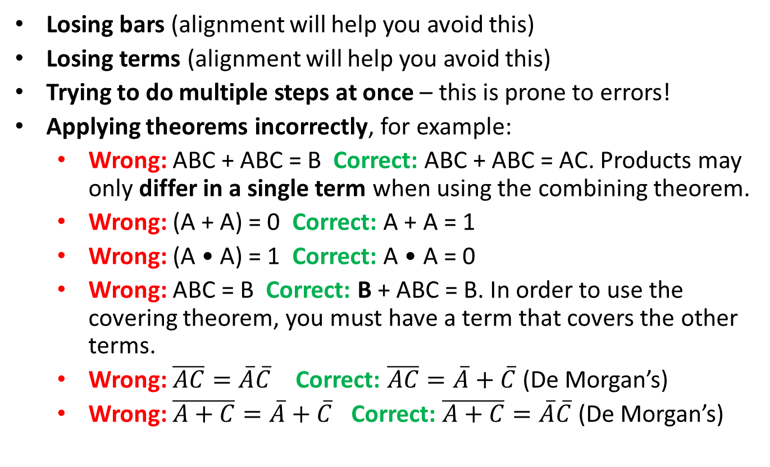
Common Errors
Losing bars (alignment will help you avoid this)
Losing terms (alignment will help you avoid this)
Trying to do multiple steps at once – this is prone to errors!
Applying theorems incorrectly, for example:
Wrong: ABC + ABC = B Correct: ABC + ABC = AC. Products may only differ in a single term when using the combining theorem.
Wrong: (A + A) = 0 Correct: A + A = 1
Wrong: (A • A) = 1 Correct: A • A = 0
Wrong: ABC = B Correct: B + ABC = B. In order to use the covering theorem, you must have a term that covers the other terms.
Wrong: $\overline{AC}=\overline{A}\overline{C}$ Correct: $\overline{AC}=\overline{A}+\overline{C}$(De Morgan’s)
Wrong: $\overline{A+C}=\overline{A}+\overline{C}$ Correct: $\overline{A+C}=\overline{A}\overline{C}$ (De Morgan’s)

Slide 73
Common Errors with De Morgan’s
Not starting from the outside parentheses and working in: this often causes additional steps.
Trying to apply De Morgan’s theorem to an entire complex operation (instead of just to terms ANDed under a bar or terms ORed under a bar)
Losing bars. Remember that applying the De Morgan’s Theorem is a 3 step process. For a product term under a bar:
Change ANDs to ORs (or vice versa for a sum term under a bar)
Bring down the terms
Put bars over the individual terms
Not keeping terms associated (i.e., losing parentheses)
For example, ABC = (A+B+C)
Example error:
Wrong: (ABC)’C+D’ = A’+B’+C’C + D’ = A’ + B’ + D’
Correct: (ABC)’C + D’ = (A’+B’+C’)C + D’ = A’C+B’C + D’

Slide 74
Chapter 2: Combinational Logic
From Logic to Gates

Slide 75
From Logic to Gates
Build the following equation using logic gates:
Y = AB + CDE

Slide 76
Circuit Schematics Rules
Inputs on the left (or top)
Outputs on right (or bottom)
Gates flow from left to right
Straight wires are best

Slide 77
Circuit Schematic Rules (cont.)
Wires always connect at a T junction
A dot where wires cross indicates a connection between the wires
Wires crossing without a dot make no connection

Slide 78
Two-Level Logic
Two-level logic: ANDs followed by ORs
Example: Y = ABC + ABC + ABC
Implements functions in SOP form

Slide 79
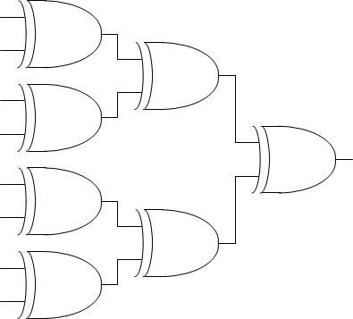
Multilevel Logic
Complex logic is often built from many stages of simpler gates.

Slide 80
Multiple-Output Circuits
Example: Priority Circuit
Output asserted
corresponding to most
significant TRUE input

Slide 81
Priority Circuit Hardware
Y₃ = A₃
Y₂ = A₃ A₂
Y₁ = A₃ A₂ A₁
Y₀ = A₃ A₂ A₁ A₀

Slide 82
Don’t Cares
Y₃ = A₃
Y₂ = A₃ A₂
Y₁ = A₃ A₂ A₁
Y₀ = A₃ A₂ A₁ A₀

Slide 83
Chapter 2: Combinational Logic
Two-Level
Logic Forms

Slide 84
Two-Level Logic Variations
ANDs followed by ORs: SOP form
ORs followed by ANDs: POS form
Only NAND gates: SOP form
Only NOR gates: POS form
Most common form of two-level logic

Slide 85
Two-Level Logic Variation
Two-level logic variation: ORs followed by ANDs
Example: Y = (A+B)(A+B+C)
Implements functions in POS form

Slide 86
Two-Level Logic
Two-level logic: ANDs followed by ORs → NANDs
Example: Y = ABC + ABC + ABC
Both: SOP form
Put bubbles on internal nodes.

Slide 87
Two-Level Logic Variation
Two-level logic: ORs followed by ANDs → NORs
Example: Y = (A+B)(A+B+C)
Both: POS form
Put bubbles on internal nodes.

Slide 88
Chapter 2: Combinational Logic
Bubble Pushing

Slide 89
De Morgan’s Theorem
# | Theorem | Dual | Name
T12 | B•C•D… = B+C+D… | B+C+D…= B•C•D… | De Morgan’s Theorem

Slide 90
De Morgan’s Theorem
Example D1:
Y = A+BC
= A•BC
= A•BC
= ABC
Work from the outside in
(i.e., top bar, then down)
Use involution when possible

Slide 91
DeMorgan’s Theorem
Example D2:
Y = A+BC+AB
= A•BC •AB
= A•BC •(A + B)
= ABC •(A + B)
= ABCA + ABCB
= ABC
De Morgan applies to:
Products under a bar
Sums under a bar
Do not try to apply DeMorgan’s to a mix of operations

Slide 92
De Morgan’s Theorem
Example D2:
Y = A+BC+AB
= A•BC •AB
= A•BC •(A + B)
= ABC •(A + B)
= ABCA + ABCB
= ABC
Don’t forget these parentheses!
Remember:
AB = (A + B)

Slide 93
De Morgan’s Theorem: Gates
Y = AB = A + B
Y = A + B = A B
NAND gate
two forms
NOR gate
two forms

Slide 94
Bubble Pushing
Backward:
Body changes
Adds bubbles to inputs
Forward:
Body changes
Adds bubble to output

Slide 95
Bubble Pushing
What is the Boolean expression for this circuit?
Y = AB + CD

Slide 96
Bubble Pushing Rules
Begin at output, then work toward inputs
Push bubbles on final output back
Draw gates in a form so bubbles cancel

Slide 97
Bubble Pushing Example

Slide 98
Chapter 2: Combinational Logic
X’s and Z’s, Oh My

Slide 99
Contention: X
Contention: circuit tries to drive output to 1 and 0
Actual value somewhere in between
Could be 0, 1, or in forbidden zone
Might change with voltage, temperature, time, noise
Often causes excessive power dissipation
X is also used for:
Uninitialized values
Don’t Care
Warnings:
Contention or uninitialized outputs usually indicate a bug.
Look at the context to tell meaning

Slide 100
Floating: Z
Floating, high impedance, open, high Z
Floating output might be 0, 1, or somewhere in between
A voltmeter won’t indicate whether a node is floating
But if you touch the node or your instructor walks over for a checkoff, it may change randomly
Tristate Buffer

Slide 101
Tristate Busses
Floating nodes are used in tristate busses
Many different drivers
Exactly one is active at once

Slide 102
Chapter 2: Combinational Logic
Karnaugh Maps

Slide 103
Karnaugh Maps (K-Maps)
Boolean expressions can be minimized by combining terms
K-maps minimize equations graphically
PA + PA = P

Slide 104
K-Map
Circle 1’s in adjacent squares
In Boolean expression: include only literals whose true and complement form are not in the circle
Y = AB Y = ABC+ABC = AB

Slide 105
3-Input K-Map
Circle 1’s in adjacent squares
In Boolean expression: include only literals whose true and complement form are not in the circle
Y = AB + BC

Slide 106
Some Definitions
Complement: variable with a bar over it
A, B, C
Literal: variable or its complement
A, A, B, B, C, C
Implicant: product of literals
ABC, AC, BC
Prime implicant: implicant corresponding to the largest circle in a K-map

Slide 107
K-Map Rules
Every 1 must be circled at least once
Each circle must span a power of 2 (i.e. 1, 2, 4) squares in each direction
Each circle must be as large as possible
A circle may wrap around the edges

Slide 108
4-Input K-Map

Slide 109
4-Input K-Map

Slide 110
Chapter 2: Combinational Logic
Karnaugh Maps with Don’t Cares

Slide 111
K-Map Rules
Every 1 must be circled at least once
Each circle must span a power of 2 (i.e. 1, 2, 4) squares in each direction
Each circle must be as large as possible
A circle may wrap around the edges
Circle a “don't care” (X) only if it helps minimize the equation

Slide 112
K-Maps with Don’t Cares

Slide 113
K-Maps with Don’t Cares

Slide 114
Chapter 2: Combinational Logic
Combinational Building Blocks: Multiplexers

Slide 115
Multiplexer (Mux)
Selects between one of N inputs to connect to output
Select input is log₂N bits – control input
Example: 2:1 Mux

Slide 116
2:1 Multiplexer Implementations
Logic gates
Sum-of-products form
Tristates
Two tristates
Turn on exactly one to select the appropriate input
116

Slide 117
4:1 Multiplexer Implementations
4:1 Mux Symbol
2-Level Logic
Tristates
Hierarchical
117

Slide 118
Logic using Multiplexers
Using mux as a lookup table

Slide 119
Chapter 2: Combinational Logic
Combinational Building Blocks: Decoders

Slide 120
Decoders
N inputs, 2^{N} outputs
One-hot outputs: only one output HIGH at once

Slide 121
Decoder Implementation

Slide 122
Logic Using Decoders
OR the minterms:

Slide 123
Chapter 2: Combinational Logic
Timing

Slide 124
Timing
Delay: time between input change and output changing
How to build fast circuits?

Slide 125
Propagation & Contamination Delay
Propagation delay: t_{pd} = max delay from input to output
Contamination delay: t_{cd} = min delay from input to output

Slide 126
Propagation & Contamination Delay
Delay is caused by
Capacitance and resistance in a circuit
Speed of light limitation
Reasons why t_{pd} and t_{cd} may be different:
Different rising and falling delays
Multiple inputs and outputs, some of which are faster than others
Circuits slow down when hot and speed up when cold

Slide 127
Critical (Long) & Short Paths
Critical (Long) Path: t_{pd} = 2t_{pd_AND} + t_{pd_OR} (max delay)
Short Path: t_{cd} = t_{cd_AND} (min delay)

Slide 128
Glitches
When a single input change causes an output to change multiple times

Slide 129
Glitch Example
What happens when A = 0, C = 1, B falls?

Slide 130
Glitch Example (cont.)

Slide 131
Fixing the Glitch

Slide 132
Why Understand Glitches?
Because of synchronous design conventions (see Chapter 3), glitches don’t cause problems.
It’s important to recognize a glitch: in simulations or on oscilloscope.
We can’t get rid of all glitches – simultaneous transitions on multiple inputs can also cause glitches.

Slide 133
About these Notes
Digital Design and Computer Architecture Lecture Notes
© 2021 Sarah Harris and David Harris
These notes may be used and modified for educational and/or non-commercial purposes so long as the source is attributed.

